Slide 1
Computer Networks
Point to Point Protocol (PPP)
S.V.Jansi Rani
Associate Professor / CSE

Slide 2
Agenda
Point to Point Protocol (PPP)
Services
Transition Phases
Multiplexing
Link Control Protocol
Authentication Protocols
PAP
CHAP
Network Control Protocols
IPCP

Slide 3



Slide 4
POINT-TO-POINT PROTOCOL
HDLC is a general protocol that can be used for both point-to-point and multipoint configuration
Point-to-Point Protocol (PPP) - point-to-point access
PPP is a byte-oriented protocol.
Internet users who need to connect their home computers to the server of an Internet service provider use PPP.

Slide 5
PPP - Services
PPP defines the format of the frame to be exchanged between devices. (byte stuffing)
Defines how two devices can negotiate the establishment of the link and the exchange of data.
Authentication - optional.
New - Multilink PPP - connections over multiple links.
One interesting feature of PPP is that it provides
network address configuration. This is particularly useful when a home user needs a emporary network address to connect to the Internet.
Multi protocol support
Error Detection

Slide 6
PPP - Services Not Provided
No flow control - overwhelm receiver
Simple error control -CRC
Corrupted frame – discarded

Slide 9
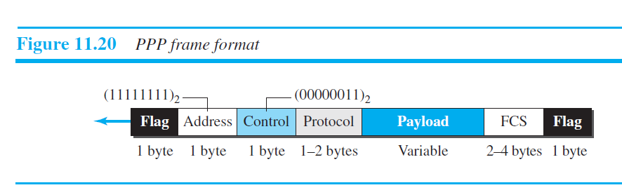
PPP frame format
Protocol - Data / Info
Payload - 1500 bytes , unused remaining padded

Slide 10

Note
PPP is a byte-oriented protocol using byte stuffing with the escape byte 01111101.

Slide 11
Transition phases

Slide 12
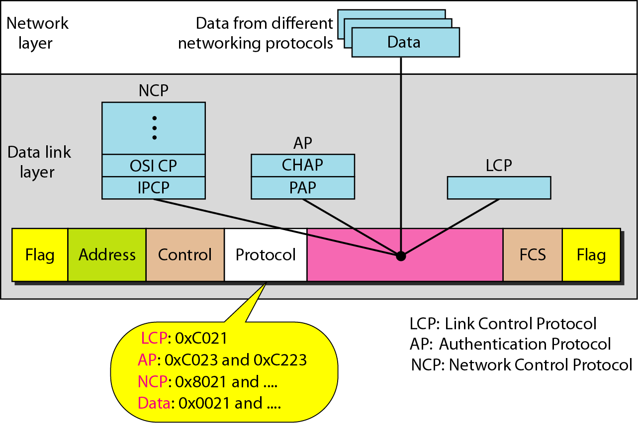
Multiplexing in PPP

Slide 13
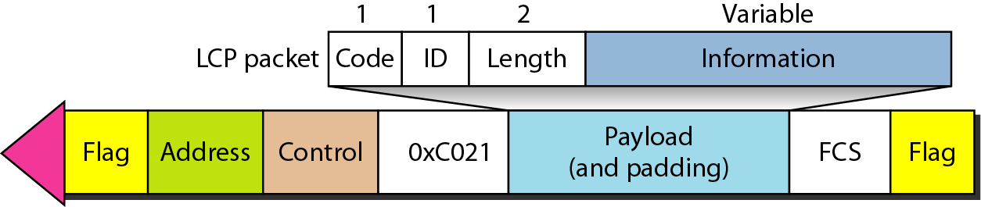
LCP packet encapsulated in a frame

Slide 14
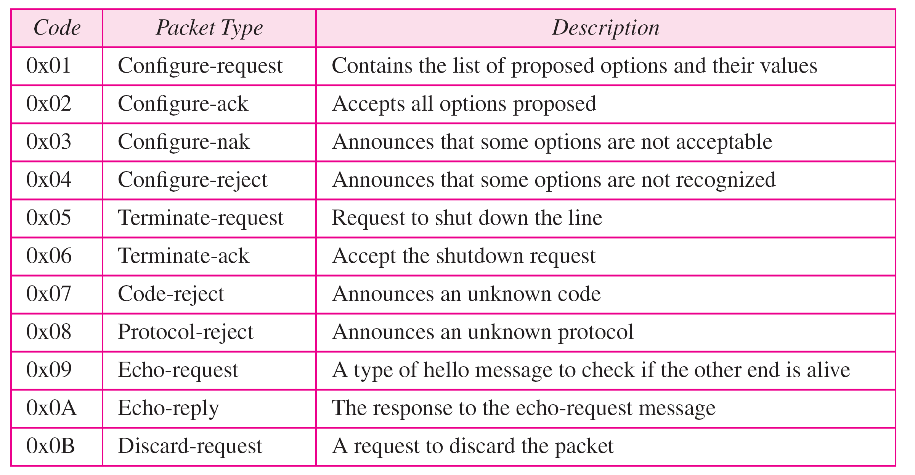
LCP packets
Link configuration 1-4, Link termination 5,6 , Link Monitoring

Slide 15
Common options

Slide 16
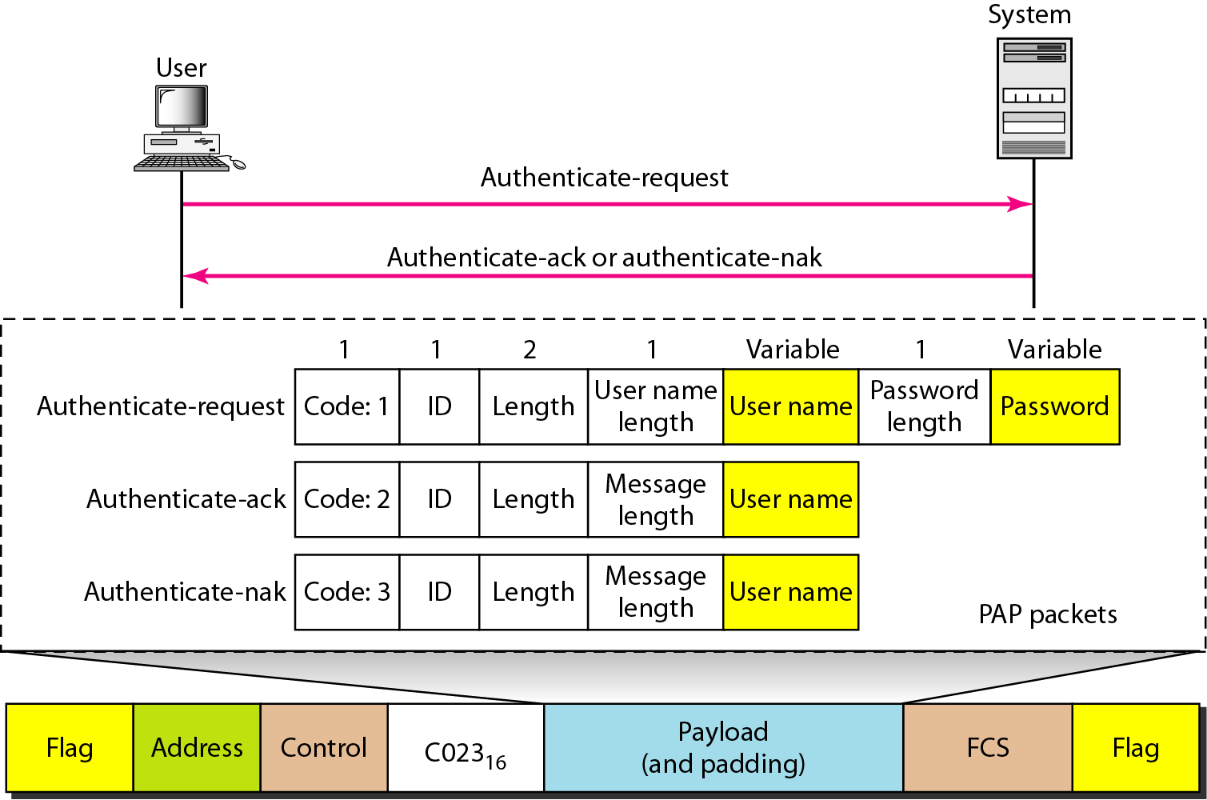
Password Authentication Protocol PAP
PAP packets encapsulated in a PPP frame

Slide 17
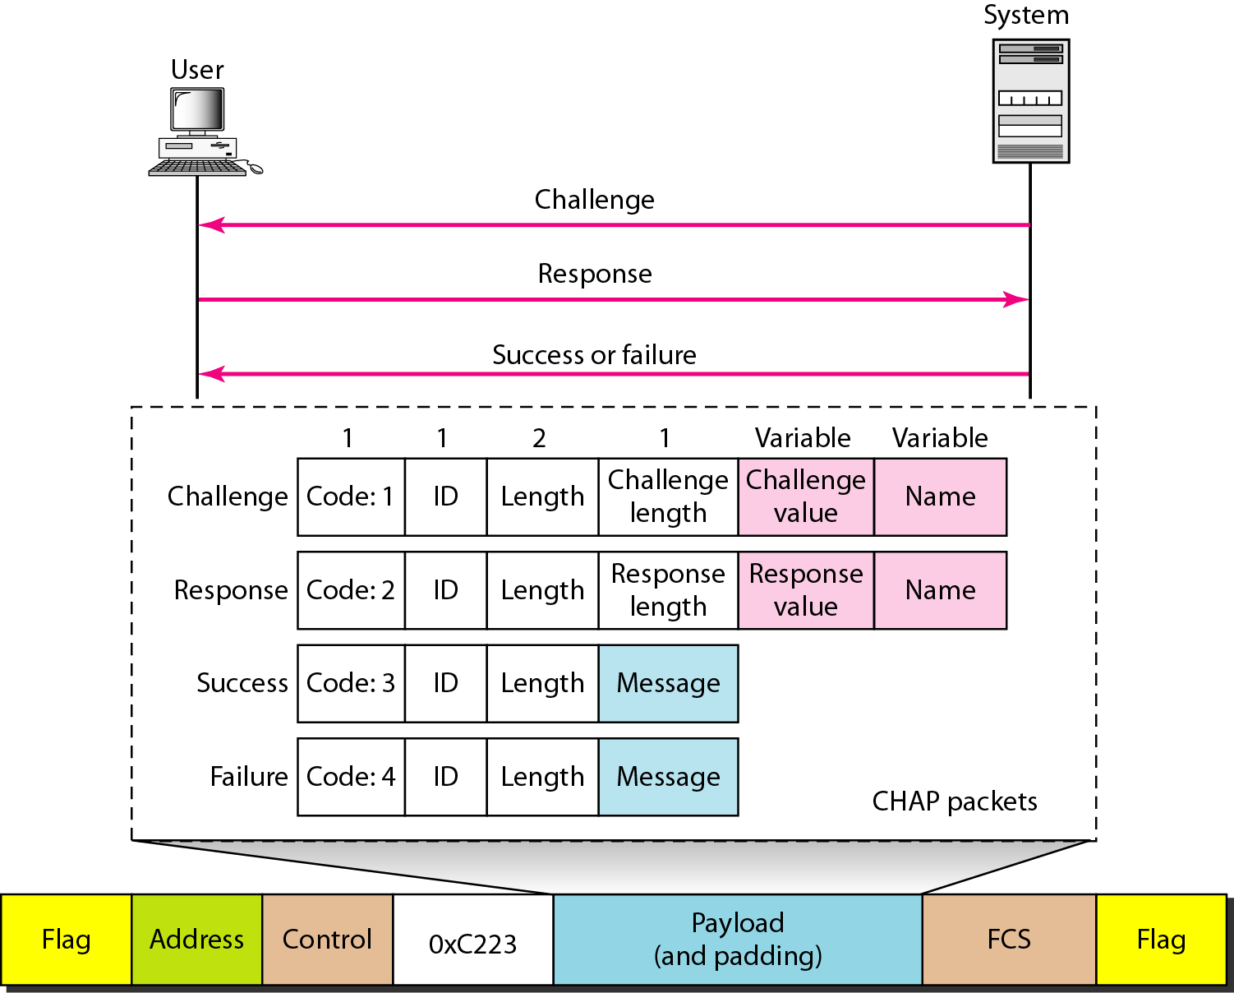
Challenge Handshake Authentication Protocol CHAP
CHAP packets encapsulated in a PPP frame

Slide 18
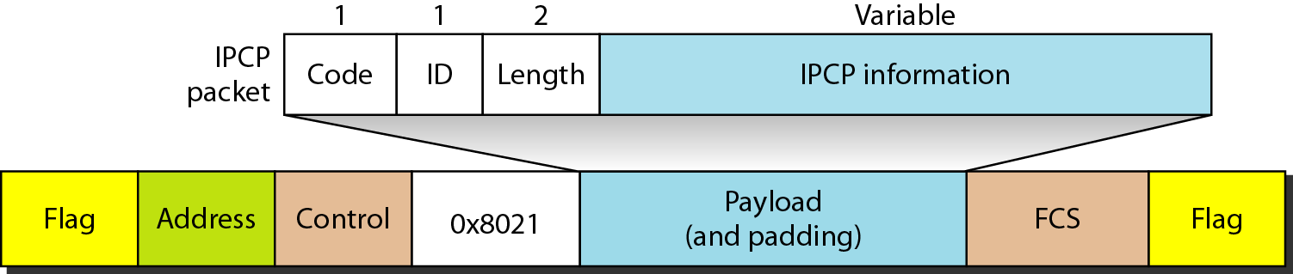
Internet Protocol Control Protocol (IPCP)
IPCP packet encapsulated in PPP frame

Slide 19
Code value for IPCP packets

Slide 20
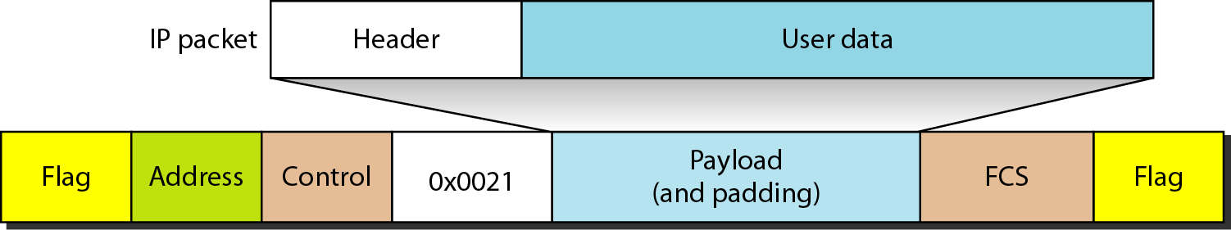
IP datagram encapsulated in a PPP frame

Slide 21
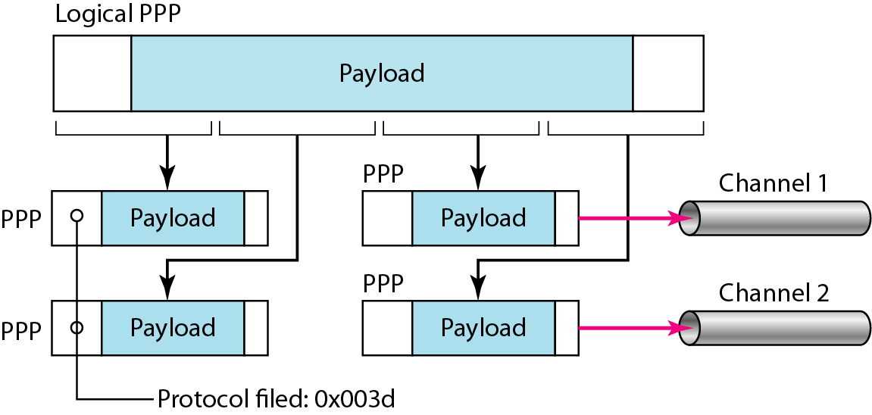
Multilink PPP

Slide 22
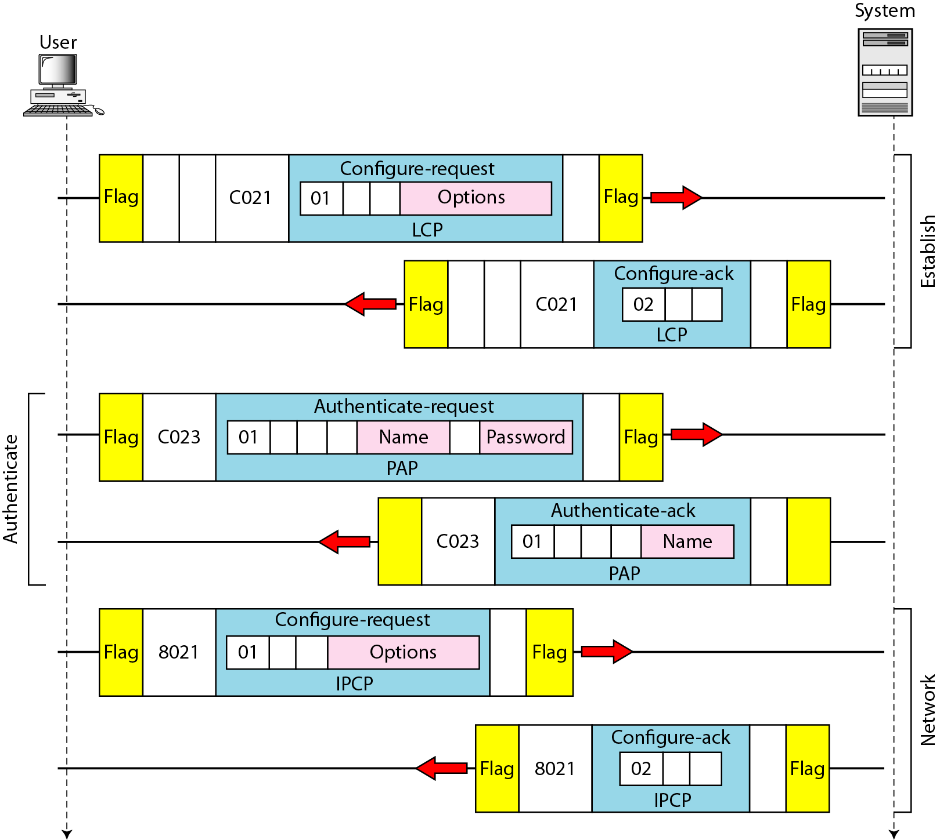
An example

Slide 23
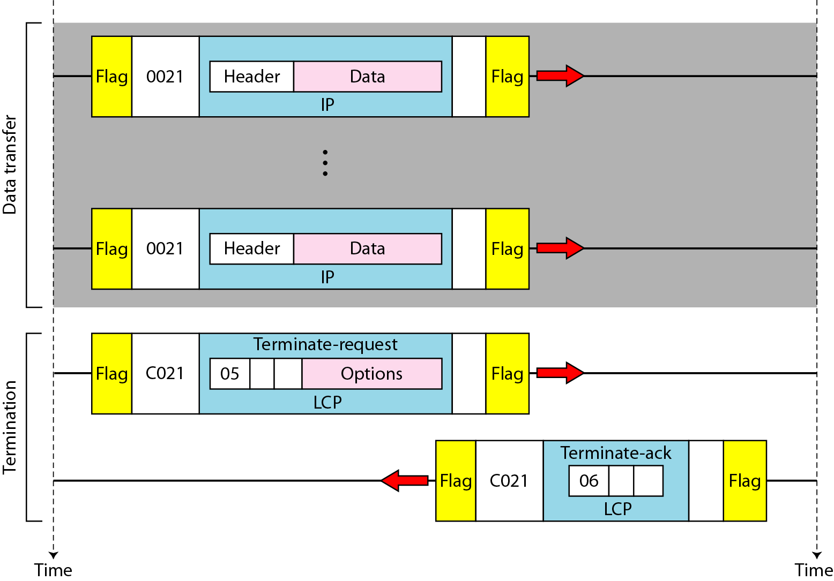
An example (continued)

Slide 24
Outcome
Student should be able to
Demonstarte the working principle behind PPP protocol
Explain the various Authentication, Network control and Data link protocols

Slide 25
THANK YOU

